Slide 1

REVIEW 2
Enterprise-Scale Real-Time
E-Commerce Data Platform
Fundamentals of Data Engineering – 24DEA3101R
Team No: 9 | Section: 7
SUBMITTED BY
UNDER THE GUIDANCE OF
T. Viswanath Reddy
2420030478
Dr. N. Sirisha
Siril Punna
2420030300
Associate Professor
D. Kamal Kumar
2420030290

Slide 2




REVIEW 2
Project Abstract
Modern e-commerce platforms generate massive, continuous streams of data from product views, orders, payments, inventory changes, and clickstream activity. Traditional batch systems struggle to turn this data into timely insight. This project builds a unified real-time and batch data platform: events are ingested through Apache Kafka, processed with Apache Spark Structured Streaming, and organized in a cloud data lake (Amazon S3) using a Bronze-Silver-Gold medallion architecture. Apache Airflow orchestrates batch workflows into a business-ready warehouse (Redshift/Snowflake), while Power BI and Tableau dashboards surface revenue, orders, conversion, and inventory metrics as they happen — all built with data quality, security, fault tolerance, and scalability in mind.
Real-Time Ingestion
Stream Processing
Medallion Lake
Live BI Dashboards
Apache Kafka
Spark Structured Streaming
Bronze → Silver → Gold
Power BI / Tableau
Enterprise-Scale Real-Time E-Commerce Data Platform
2

Slide 3



REVIEW 2
Introduction
The Problem
WHY REAL-TIME MATTERS
Every interaction on an e-commerce platform — searches, clicks, cart activity, orders, payments, reviews, and inventory updates — generates data with real business value. Traditional pipelines rely on batch processing: data is collected and analyzed only at fixed intervals.
That works for historical reporting, but it cannot surface a sudden demand spike, a suspicious transaction, or a stock-out the moment it happens — businesses are left waiting for tomorrow's report to react to today's event.
This project addresses that gap by combining streaming and batch processing into one unified platform: Kafka and Spark Structured Streaming handle real-time events, while Airflow-orchestrated batch jobs keep the medallion data lake and warehouse consistent — giving both instant visibility and reliable historical analytics from the same pipeline.
Sudden Demand Spikes
Catch a surge in product demand as it happens, not the next day.
Fraud & Anomaly Detection
Flag suspicious transactions in the moment they occur.
Live Inventory Signals
Monitor stock levels continuously to avoid over-selling.
Faster Decisions
Give business teams metrics that reflect the current second.
Enterprise-Scale Real-Time E-Commerce Data Platform
3

Slide 4


REVIEW 2
Objectives
Unified Pipeline
Low-Latency Ingestion
Medallion Data Lake
Design one platform that combines real-time streaming and batch processing for enterprise e-commerce data.
Ingest high-velocity events — clicks, orders, payments, inventory — through Apache Kafka with minimal delay.
Organize raw-to-refined data on Amazon S3 using a Bronze-Silver-Gold layered architecture.
Reliable Orchestration
Enterprise Reliability
Real-Time BI
Automate batch workflows with Apache Airflow into a business-ready Redshift/Snowflake warehouse.
Build in data quality checks, security, fault tolerance, and scalability across the platform.
Deliver Power BI / Tableau dashboards that turn live data into faster, data-driven decisions.
Enterprise-Scale Real-Time E-Commerce Data Platform
4

Slide 5
REVIEW 2
Part 1 of 2
Literature Survey
1
Big Data: Principles and Best Practices of Scalable Real-Time Data Systems
2
Big Data Real-Time Clickstream Data Ingestion Paradigm for E-Commerce Analytics
N. Marz & J. Warren (2013)
G. Pal, G. Li & K. Atkinson, IEEE I2CT (2018)
Focus: Introduced the Lambda Architecture, combining a batch layer and a speed layer to serve both historical and real-time views of data.
Focus: Proposed a Kafka-Flume-Spark-Cassandra pipeline for high-velocity, fault-tolerant clickstream ingestion in e-commerce.
Gap: Running separate batch and streaming codebases increases engineering complexity and long-term maintenance overhead.
Gap: Concentrates on the ingestion layer alone, without a structured warehouse or business-ready analytics layer.
Relevance: This project adopts the layered Bronze-Silver-Gold medallion model as a simpler, unified alternative to a dual batch/speed codebase.
Relevance: This project extends that ingestion approach with a full medallion lake and warehouse layer for business-ready analytics.
Enterprise-Scale Real-Time E-Commerce Data Platform
5

Slide 6
REVIEW 2
Part 2 of 2
Literature Survey
3
Real-Time Text Analytics Pipeline Using Open-Source Big Data Tools
4
Real-Time Analytics: Algorithms and Systems
H. Nazeer, W. Iqbal, F. Bokhari, F. Bukhari & S. U. R. Baig
A. Kejariwal, S. Kulkarni & K. Ramasamy, Twitter Inc.
Focus: Built a Kafka-Spark-Cassandra pipeline achieving sub-minute latency while processing high-throughput social data streams.
Focus: Surveyed streaming analytics algorithms and platforms across e-commerce, finance, and telecom domains.
Gap: Evaluated only on social-media/text streams; not tested against structured, transactional e-commerce workloads.
Gap: Remains a platform-agnostic survey; it does not propose one concrete, deployable enterprise architecture.
Relevance: Validates that a similar Kafka-Spark approach can be adapted here for structured e-commerce order and event data.
Relevance: This project operationalizes those concepts into a concrete Kafka-Spark-Airflow-Redshift architecture with live dashboards.
Enterprise-Scale Real-Time E-Commerce Data Platform
6

Slide 7
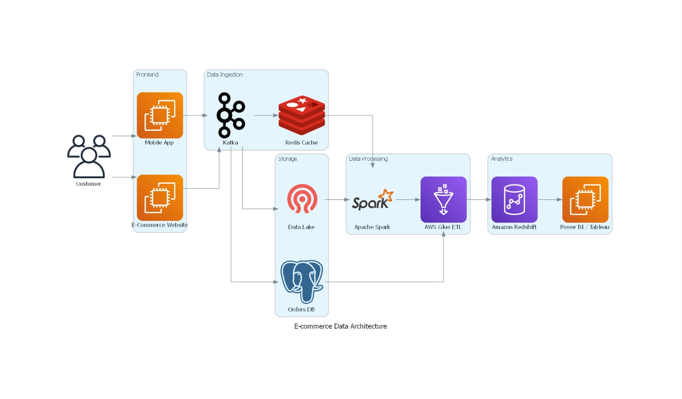
REVIEW 2
System Architecture
Enterprise-Scale Real-Time E-Commerce Data Platform
7

Slide 8


REVIEW 2
Technology Stack & Key Components
Apache Kafka
Apache Spark
Amazon S3
Apache Airflow
Real-time event ingestion
Structured streaming processing
Bronze / Silver / Gold data lake
Batch workflow orchestration
Redshift / Snowflake
Power BI / Tableau
Data Quality & Security
Fault Tolerance & Scale
Business-ready data warehouse
Real-time interactive dashboards
Validation, access control, governance
Monitoring for enterprise workloads
Enterprise-Scale Real-Time E-Commerce Data Platform
8

Slide 9
THANK YOU
Questions & Discussion
T. Viswanath Reddy • Siril Punna • D. Kamal Kumar
Team No. 9 | Section 7 | Fundamentals of Data Engineering – 24DEA3101R

